Slide 1
Graphics and Computational Programming
Alex Emeny

Slide 2
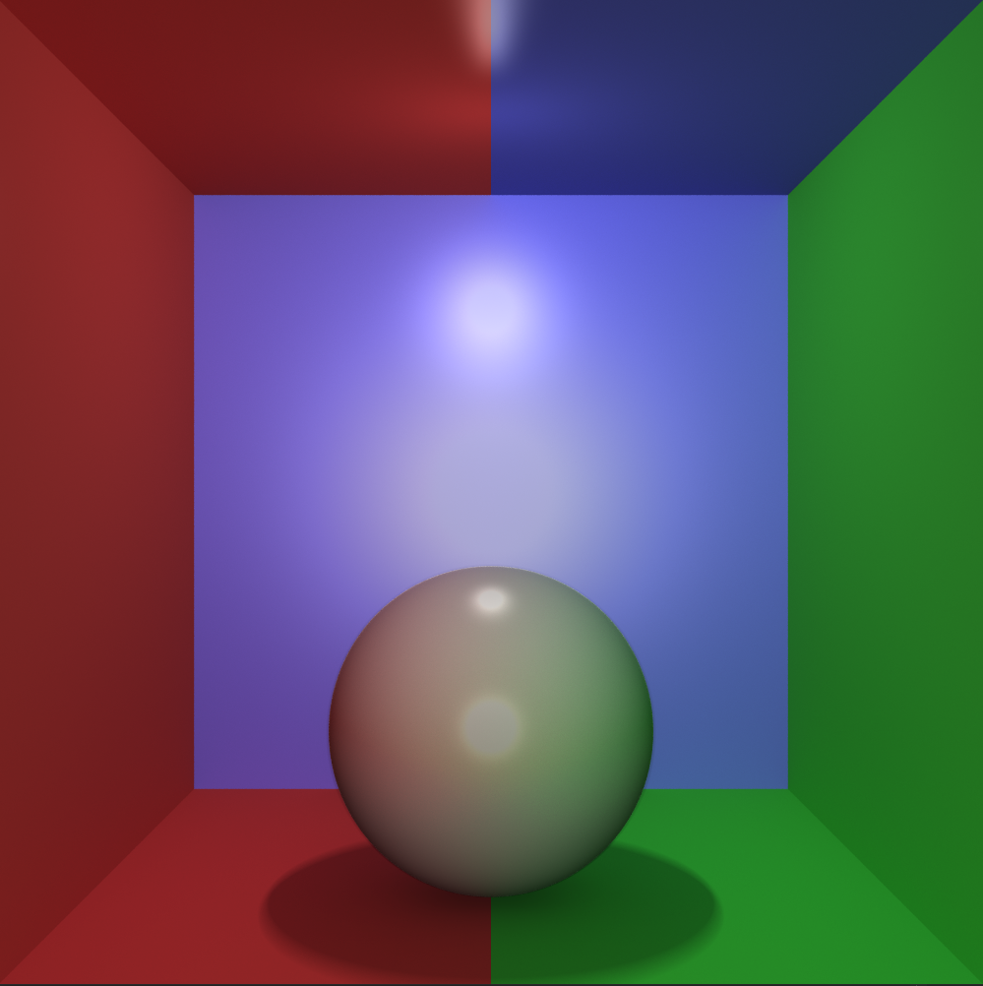
Presentation Overview
Theory
Design
Demo
Analysis
Evaluation

Slide 3
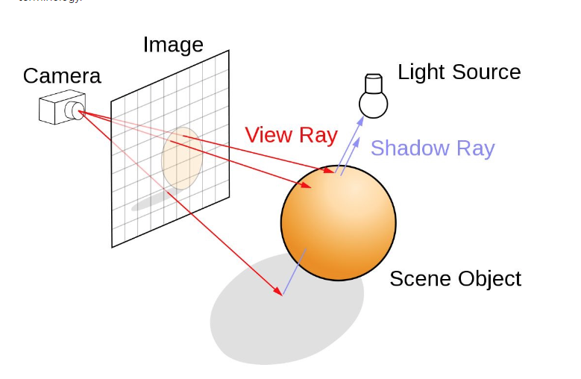
Theory – Ray tracing
Ray tracing is a rendering technique that is used to simulate realistic lighting in each scene by creating accurate reflections, refractions, shadows and indirect lighting.
Ray tracing generates a path from the view of a camera, through the 2D viewing plane into a 3D scene.
Can be inaccurate from the real world due to computational limits with modern-day computers.
Ray Tracing | NVIDIA Developer

Slide 4
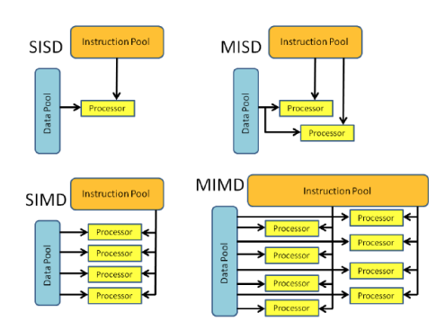
Theory – Parallel programming
A problem is broken into parts that can be solved concurrently.
Instructions from each part are executed simultaneously on different cores.
In theory, the more resources allocated to the problem the shorter the time to finish.
socials-20151110-rivi.pdf (ucl.ac.uk)

Slide 5
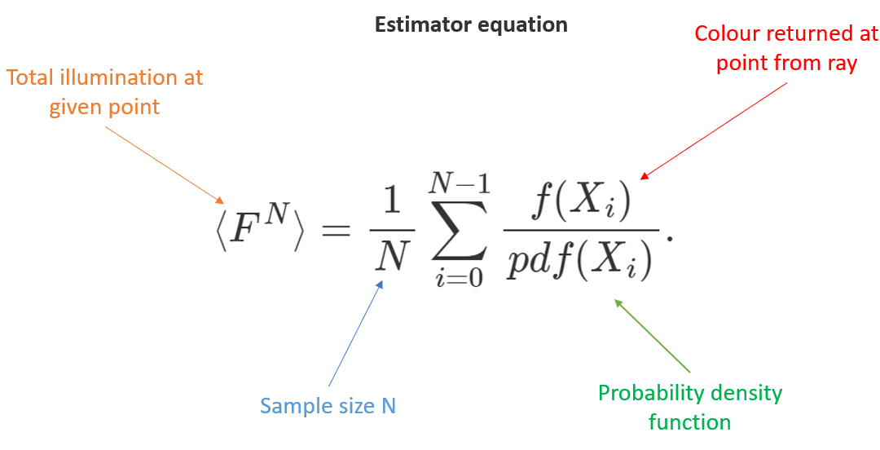
Theory – Monte Carlo Global Illumination
The Monte Carlo method looks at the amount of colour that would fall onto a surface from indirect lighting.
The main problem with this technique is that the path tracing is slow and creates noisy images.
Monte Carlo theory states that to reduce noise level by two you would need four times the samples, which rapidly gets expensive to calculate for each ray.
Rays are fired in random directions from a hemisphere, and the average colour is accumulated from the samples taken.

Slide 6
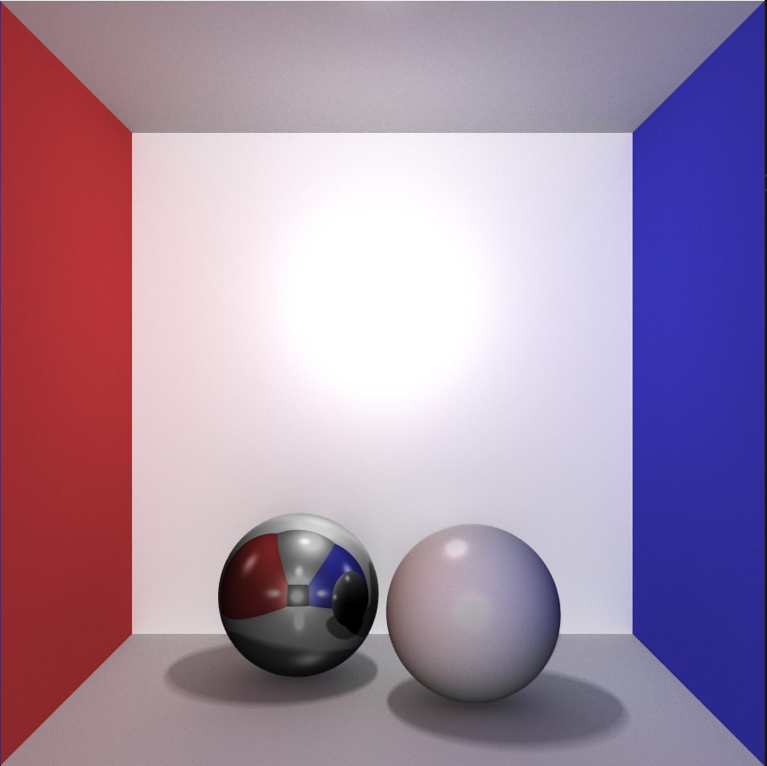
Design – My features
Multithreading / thread pooling
Multi-bounce reflections
Soft shadows
Global Illumination
Anti-aliasing
Multi-light sources

Slide 7
Design – Flow diagram
Start
AA Samples
Draw Pixel
Shadow Check
True
Bounces Left
> 0
False
True
Global Ill
> 0
False
Specular
Lighting
Shade
Calculation
Another Light
All lights
done
Each Light

Slide 8
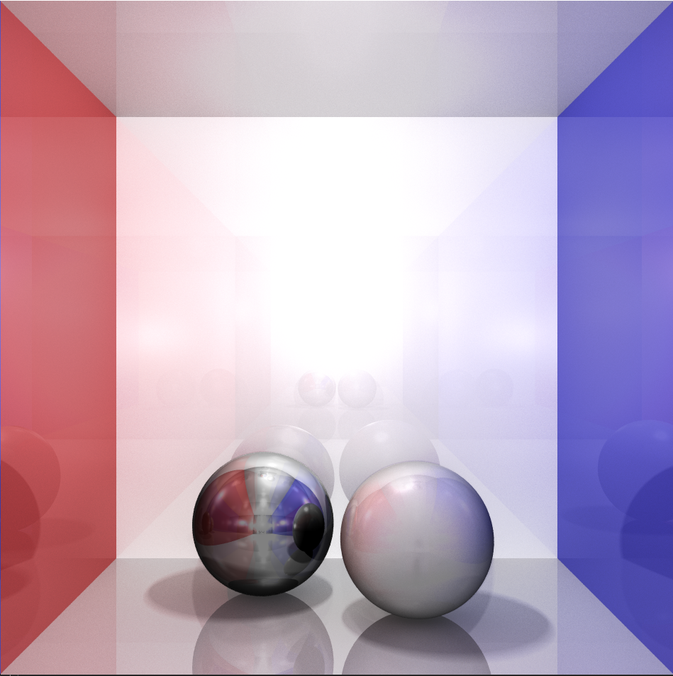
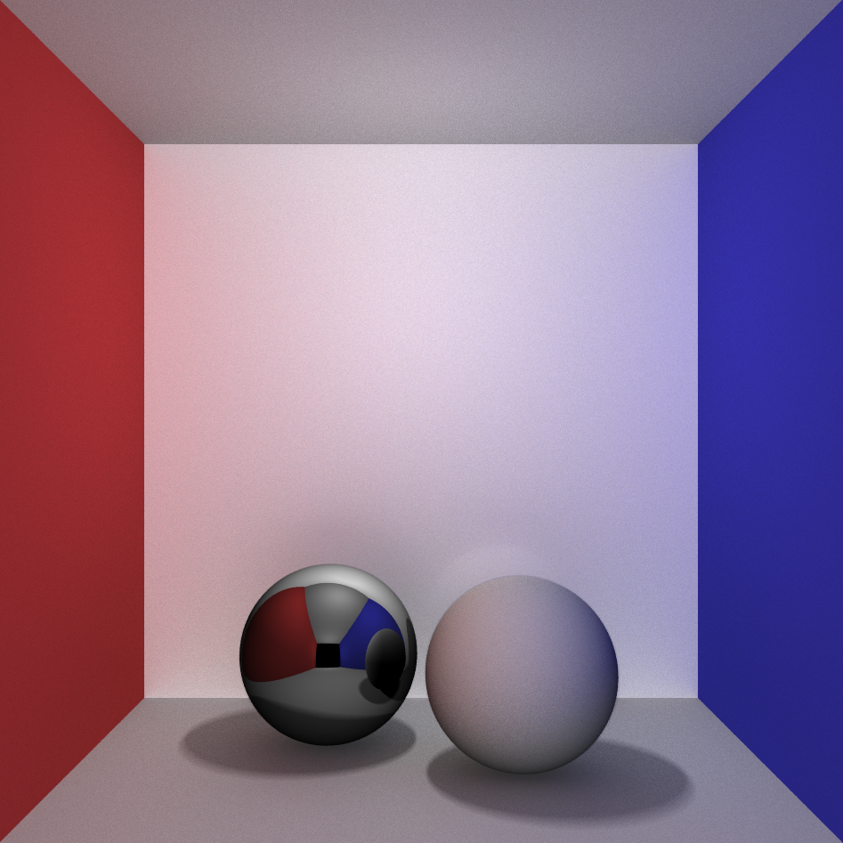
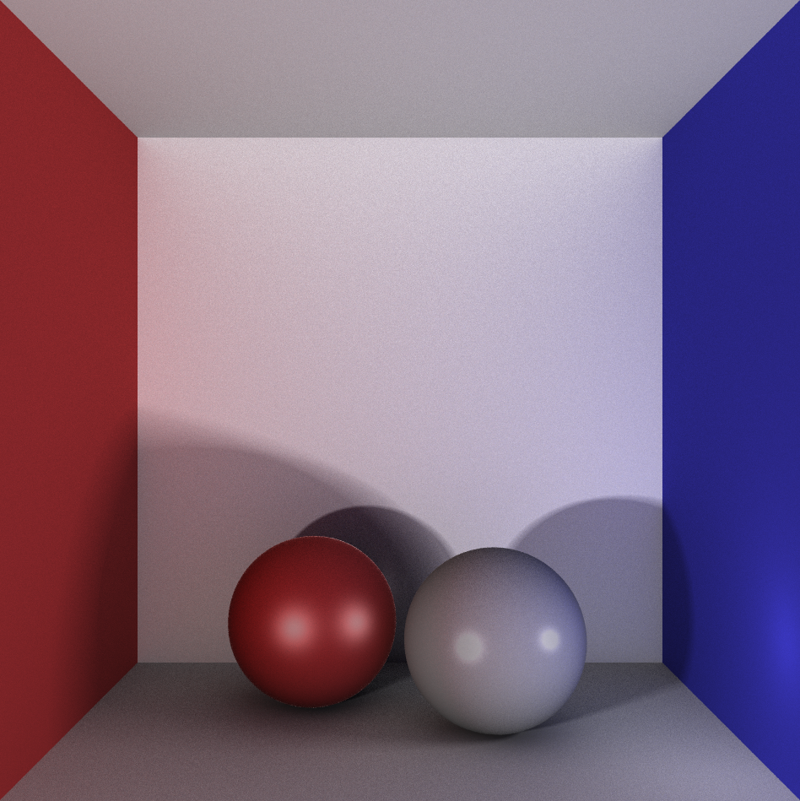
Demo

Slide 9
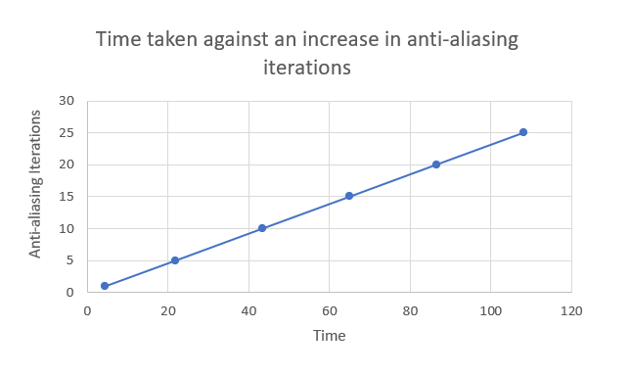
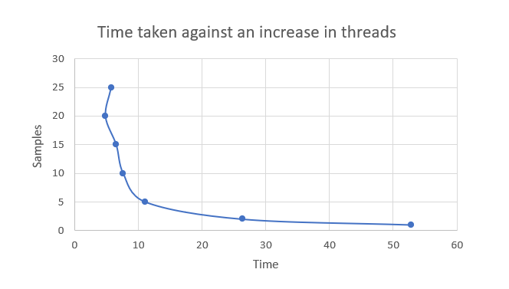
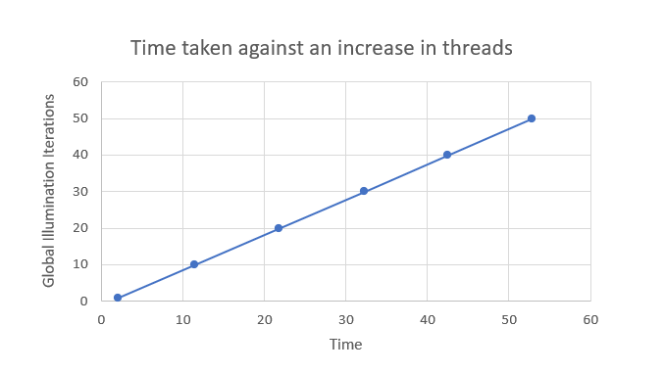
Analysis

Slide 10
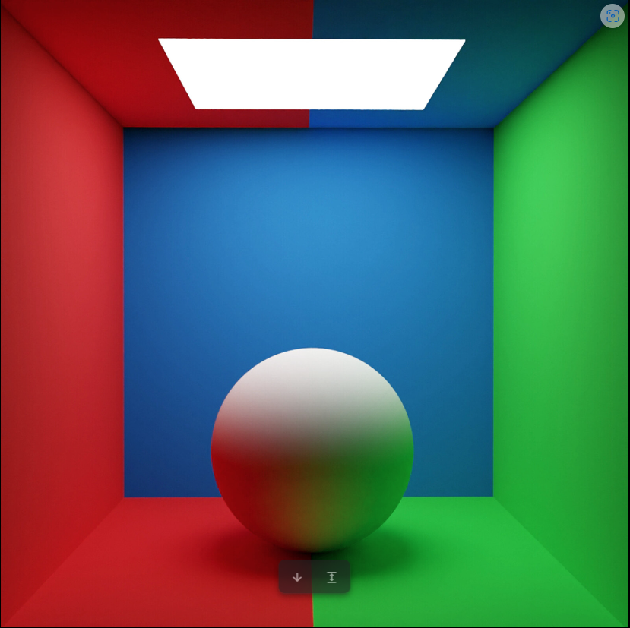
ArtStation - Cornell box render For Testing a Global Illumination
My reference renders
My renders Features: Reference Renders Features:
-Global Illumination -Global Illumination
-Specular lighting -Anti-aliasing
-Multi-light sources -Box Light
-Anti-aliasing
-Soft shadows
My render

Slide 11
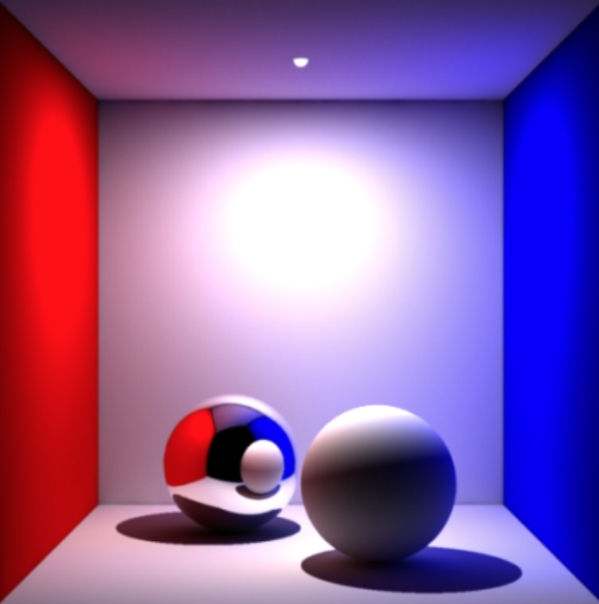
My reference renders
My renders Features: Reference Renders Features:
-Global Illumination -Global Illumination
-Specular lighting -Reflective bounces
-Reflective bounces -Anti-aliasing
-Anti-aliasing
-Soft shadows
-Multi-light sources
Global Illumination and All That (seanet.com)
My render

Slide 12
Evaluation
My Ray Tracer Overview
Overall, my ray tracer has many different features and tools to change how the scene can look.
Kept the ray tracer dynamic so no matter how the scene will be set up the program will always render as it’s supposed to.
The program is an offline ray tracer that utilizes the CPU for its computation.
Testing out different values for the best visual quality compared to computation time appeared to be, 40 Anti-aliasing, 30 Soft Shadows, 30 Global Illumination, two light sources on 20 threads.
The use of a recursive trace ray function to return the shade of an intersect came in very useful when needing to calculate reflections and global illumination.
The test data has shown me that the use of thread pool and multithreading is vital when using a heavy computational program.
Using less computational heavy algorithms over others.
What I would do differently
Add refraction alongside reflections.
Change the program from CPU rendering to GPU rendered.

Slide 13

References
Generating random points in a sphere (no date) Generating Random Points in a Sphere | Karthik Karanth. Available at: https://karthikkaranth.me/blog/generating-random-points-in-a-sphere/ (Accessed: 25 November 2023).
Global Illumination and Path Tracing (No date) Global illumination and path tracing. Available at: https://www.scratchapixel.com/lessons/3d-basic-rendering/global-illumination-path-tracing/introduction-global-illumination-path-tracing.html (Accessed: 03 December 2023).
Parallel computing: A brief discussion - UCL (no date) Parallel computing. Available at: https://www.ucl.ac.uk/advanced-research-computing/sites/advanced_research_computing/files/socials-20151110-rivi.pdf (Accessed: 12 December 2023).
(No date a) Rendering soft shadows. Available at: http://raytracerchallenge.com/bonus/area-light.html (Accessed: 26 November 2023).
Ray Tracing (no date) NVIDIA Developer. Available at: https://developer.nvidia.com/discover/ray-tracing#:~:text=Ray%20tracing%20is%20a%20rendering,%2C%20shadows%2C%20and%20indirect%20lighting. (Accessed: 12 December 2023).
Artstation - Cornell Box render for testing a global illumination (no date) Cornell Box render for testing a global illumination. Available at: https://www.artstation.com/artwork/OGoekg (Accessed: 09 December 2023).
Global illumination and all that(No date a) Global illumination and all that. Available at: https://www.seanet.com/~myandper/abstract/sig03c09.htm (Accessed: 9 December 2023).

